Slide 1
Human Computer Interaction
Evaluations – Heuristics

Slide 2
Usability Evaluation

Slide 3
Testing (real-user based) expensive
Inspection (expert based) discounted usability

Slide 4
Usability Evaluation
  Testing (real end-users)
  Inspections (usability experts)
    Also called discounted usability
    Usability experts assumes user’s role with the help of personas and scenario
Timeline of evaluation
  Exploratory evaluation (before design), only testing
  Predictive evaluation (during design), only inspection, no testing
  Formative evaluation
  Summative evaluation

Slide 5
Usability Evaluation
There are four types of evaluation, according to the purpose of the evaluation:
  Exploratory - how is it (or will it be) used?
  Predictive - estimating how good it will be.
  Formative - how can it be made better?
  Summative - how good is it?

Slide 6
Modified Soup Analogy
Stake, Robert E. [1976]. Evaluating Educational Programmes: The Need and the Response: A Collection of Resource Materials. OECD.
Lockee, Barbara, Mike Moore, and John Burton [2002]. Measuring Success: Evaluation Strategies for Distance Education. EDUCAUSE Quarterly, 25(1), pages 20–26.
“When the cook tastes other cooks’ soups, that’s exploratory.
When the cook assesses a certain recipe, that’s predictive.
When the cook tastes the soup while making it, that’s formative.
When the guests (or food critics) taste the soup, that’s summative.”

Slide 7
Exploratory Evaluation
Explores current usage and the potential design space for new designs.
  Done before interface development.
  Learn which software is used, how often, and what for.
  Collect usage data – statistical summaries and observations of usage.

Slide 8
Predictive Evaluation
Predictive evaluation uses an engineering model of human cognition to predict usability
  In this case, we will predict efficiency
The engineering model is
  Abstract
  Quantitative
  Approximate
  Estimated from user experiments
Notes:
The keystroke level model was described by Card, Moran, and Newell in the early 1980s. The model focuses on how long it takes users to actually use the HCI via hardware.

Slide 9
Advantage of Predictive evaluation
Don’t have to build UI Prototype
  Can compare design alternatives with no implementation whatsoever
Don’t have to test real live users
Theory provides explanations of UI Problems
  So it points to the areas where design can be improved
  User testing may only reveal problems, not explain them
Notes:
Predictive evaluation doesn’t need real users (once the parameters of the model have been estimated, that is).
Not only that, but predictive evaluation doesn’t even need a prototype. Designs can be compared and
evaluated without even producing design sketches or paper prototypes, let alone code.
Another key advantage is that the predictive evaluation not only identifies usability problems, but actually
provides an explanation of them based on the theoretical model underlying the evaluation. So it’s much better
at pointing to solutions to the problems than either inspection techniques or user testing. User testing might
show that design A is 25% slower than design B at a doing a particular task, but it won’t explain why.
Predictive evaluation breaks down the user’s behavior into little pieces, so that you can actually point at the
part of the task that was slower, and see why it was slower.

Slide 10
Formative Evaluation
Informs the design process and helps improve an interface during design.
Done during interface development.
Learn why something went wrong, not just that it went wrong.
Collect process data – qualitative observations of what happened and why.

Slide 11
Summative Evaluation
Assesses the overall quality of an interface.
Done once an interface is (more or less) finished.
Either compare alternative designs, or test definite performance requirements.
Collect bottom-line data – quantitative measurements of performance: how long did users take, were they successful, how many errors did they make.

Slide 12
Usability Evaluation Methods
The methods of usability evaluation can also be classified according to who performs them:
Usability Inspection Methods
  Inspection of interface design by usability specialists using heuristics and judgment (no test users).
Usability Testing Methods
  First-hand testing of interface design with real users.

Slide 13
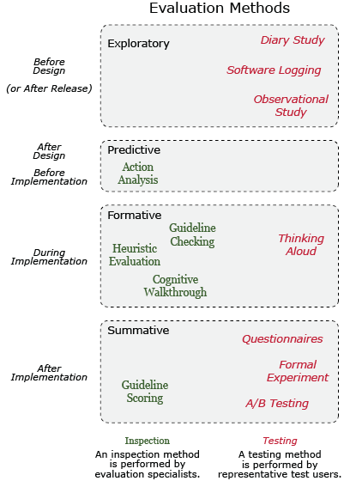
Usability Evaluations

Slide 14
Evaluation Methods
Design-oriented evaluation methods:
  Heuristic/expert inspections
  Cognitive walkthrough
Implementation-oriented methods:
  Observation
  Query techniques – interviews and surveys
  (controlled experiments)

Slide 15
Heuristic/Expert Inspections
Experts assess the usability of an interface guided by usability principles and guidelines (heuristics)
Suited to early design when some kind of representation/prototype is available
It’s only as good as the experts you can afford

Slide 16
Heuristic Evaluation Process
Briefing session
Evaluation period
Debriefing session

Slide 17
Briefing session
Evaluators + project manager
Goals of evaluation
Prototype
User description (Personas)
Context of use (User Scenario)

Slide 18
1 – Briefing Session
Briefing session
  Several experts
  All given identical description of product, its context of use and the goals of evaluation

Slide 19
2 – Evaluation
How does it work?
  Evaluators use a checklist of basic usability heuristics
  Evaluators go through an interface twice
    1st pass get a feel for the flow and general scope
    2nd pass refer to checklist of usability heuristics and focus on individual elements
  The findings of evaluators are combined and assessed

Slide 20
3 – Debriefing Session
Debriefing session
  Experts meet to compare findings, prioritise problems and propose solutions
  They report/present their findings to decision makers and other stakeholders

Slide 21
No. of evaluators & problems
Notes:
21

Slide 22
Severity Ratings
Severity ratings can help prioritize the fixing of usability problems.
After evaluation sessions, a complete aggregate list of usability problems is given/sent to each evaluator.
Working independently, evaluators assign severity rating [on scale of 0–4] to each problem.
Severity rating of single evaluator is unreliable, mean of 3–5 evaluators is satisfactory.
Score | Severity
0 | I don’t agree that this is a usability problem at all
1 | Cosmetic problem only: need not be fixed unless extra time is available on project
2 | Minor usability problem: fixing this should be given low priority
3 | Major usability problem: important to fix, so should be given high priority
4 | Usability catastrophe: imperative to fix this before product can be released

Slide 23
Nielsen’s Ten Heuristics
Visibility of system status (Provide Feedback)
Match between system and the real world (speak user’s language)
User control and freedom (Provide Clearly marked exits)
Consistency and standards
Recognition rather than recall (Reduce user’s memory load)
Flexibility and efficiency of use
Aesthetic and minimalist design
Error prevention
Help users recognize, diagnose and recover from errors
Help and documentation

Slide 24
Nielsen’s Ten Heuristics
Visibility of system status [Feedback]
    Always keep users informed about what is going on, through appropriate feedback within reasonable time. For example, if a system operation will take some time, give an indication of how long and how much is complete.
  For example: busy cursor [1–10s], progress indicator [>10s].

Slide 25
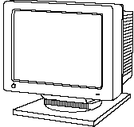
1. Provide feedback
Continuously inform the user about
  what it is doing
  how it is interpreting the user’s input
  user should always be aware of what is going on
What’s it doing?
Time for coffee.
> Doit
> Doit
This will take
5 minutes...

Slide 26
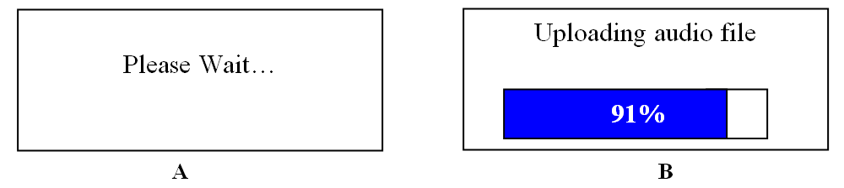
1. Provide feedback
What mode am I in now?
How is the system interpreting my actions?
What did I select?

Slide 27
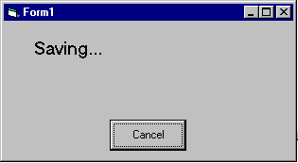
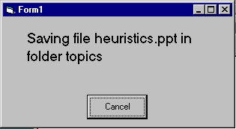
1. Provide feedback
Be as specific as possible, based on user’s input
Best within the context of the action

Slide 28
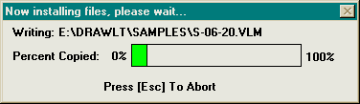
1. Provide feedback
Multiple files being copied,
but feedback is file by file.

Slide 29
1. Provide feedback
Response time
  how users perceive delays
    <0.1s perceived as “instantaneous”
    1s user’s flow of thought stays uninterrupted, but delay noticed
    10s limit for keeping user’s attention focused on the dialog
    > 10s user will want to perform other tasks while waiting

Slide 30
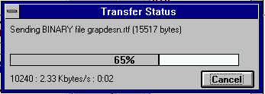
1. Provide feedback
Dealing with long delays
  Cursors
    for short transactions
  Percent done dialogs
      time left
      estimated time
  Random
    for unknown times
Contacting host (10-60 seconds)
cancel

Slide 31
Nielsen’s Ten Heuristics
Match between system and the real world [Speak the Users’ Language]
  The system should speak the user’s language, with words, phrases and concepts familiar to the user, rather than system-oriented terms. Follow real-world conventions, making information appear in natural and logical order.
  Match users’ mental model. Beware of misleading metaphors.

Slide 32




2. Speak the users’ language
My program gave me the message Rstrd Info.
What does it mean?
That’s restricted information
No, no… Rsdrd Info stands for “Restricted Information”
But surely you can tell me!!!
Hmm… but what does it mean???
It means the program is too busy to let you log on
Ok, I’ll take a coffee

Slide 33
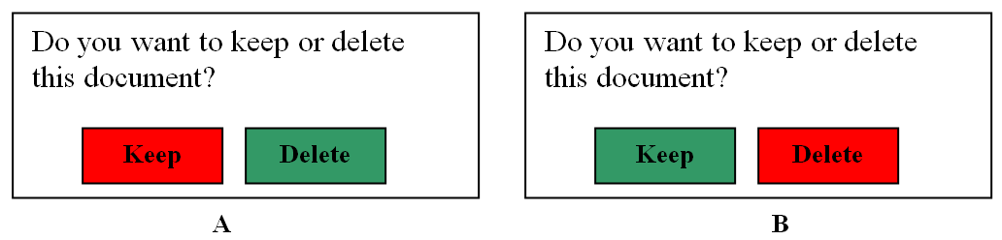
2. Speak the users’ language
Match between system and the real world

Slide 34
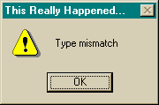
2. Speak the users’ language
Match between system and the real world

Slide 35
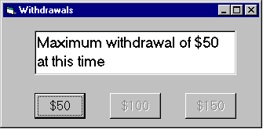
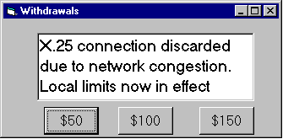

2. Speak the users’ language
Terminology based on users’ language for task
  e.g. withdrawing money from a bank machine
Use meaningful mnemonics, icons & abbreviations
  eg File / Save
    Ctrl + S (abbreviation)
    Alt FS (mnemonic for menu action)
    (tooltip icon)

Slide 36
Nielsen’s Ten Heuristics
User control and freedom [Clearly Marked Exits]
  Users often choose system functions by mistake and need a clearly marked ‘emergency exit’ to leave the unwanted state without having to go through an extended dialog. Support undo and redo.

Slide 37
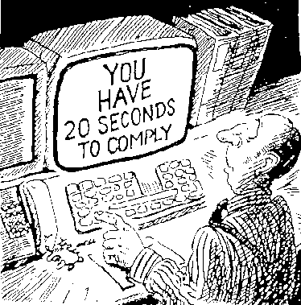
3. Provide clearly marked exits
How do I get out of this?

Slide 38
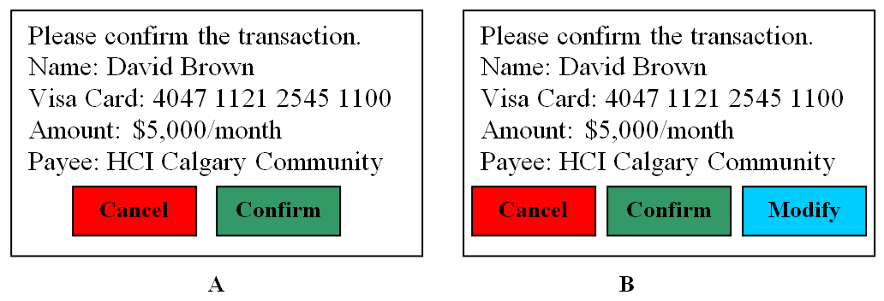
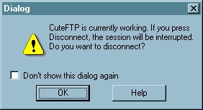
3. Provide clearly marked exits

Slide 39
3. Provide clearly marked exits
Users don’t like to feel trapped by the computer!
  should offer an easy way out of as many situations as possible
Strategies:
  Cancel button (for dialogs waiting for user input)
  Universal Undo (can get back to previous state)
  Interrupt (especially for lengthy operations)
  Quit (for leaving the program at any time)
  Defaults (for restoring a property sheet)

Slide 40
Nielsen’s Ten Heuristics
Consistency and standards
  Users should not have to wonder whether words, situations or actions mean the same thing in different contexts. Follow platform conventions and accepted standards.
Principle of Least Surprise
Consistency
  Internal
  External
  Metaphorical

Slide 41
4. Be consistent
Consistent syntax of input
Consist language and graphics
  same visual appearance across the system (e.g. widgets)
  same information/controls in same location on all windows
Consist effects
  commands, actions have same effect in equivalent situations
    predictability
Ok
Cancel
Cancel
Ok
Ok
Accept
Dismiss
Cancel

Slide 42
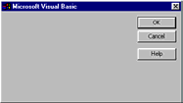
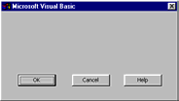
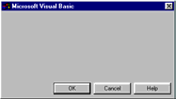
4. Be consistent

Slide 43
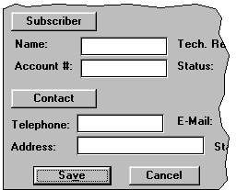
4. Be Consistent
These are labels with a raised appearance.
Is it any surprise that people try and click on them?

Slide 44
Nielsen’s Ten Heuristics
Recognition rather than recall
  Make objects, actions and options visible. The user should not have to remember information from one part of the dialog to another. Instructions for use of the system should be visible or easily retrievable whenever appropriate.
  Users’ short-term memory is limited. Provide examples, default values, easily retrievable instructions.

Slide 45
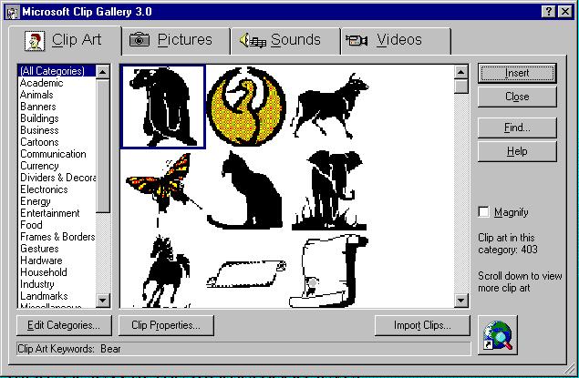
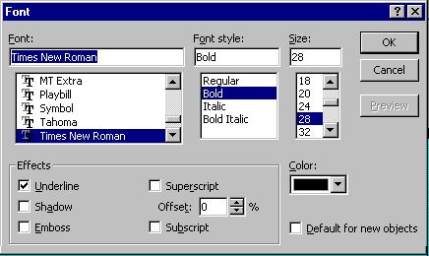
5. Minimize user’s memory load
Computers good at remembering, people are not!
Promote recognition over recall
  menus, icons, choice dialog boxes vs commands, field formats
  relies on visibility of objects to the user (but less is more!)

Slide 46
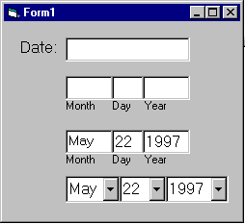
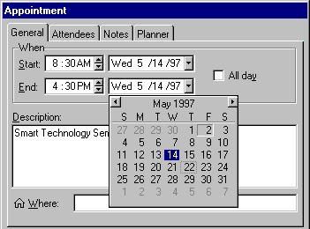
5. Minimize user’s memory load
Gives input format, example and default

Slide 47
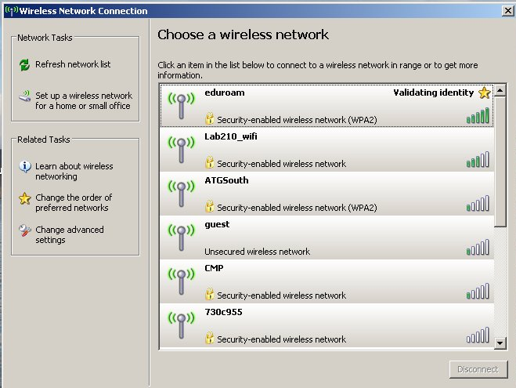
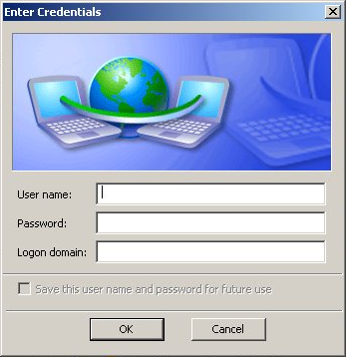
5. Minimize user’s memory load

Slide 48
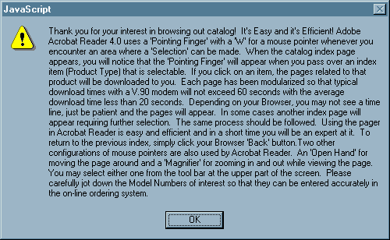
5. Minimize user’s memory load

Slide 49
Nielsen’s Ten Heuristics
Flexibility and efficiency of use [Accelerators]
  Allow users to tailor frequent actions. Accelerators – unseen by the novice user – may often speed up the interaction for the expert user to such an extent that the system can cater to both inexperienced and experienced users.
  For example: abbreviations, command keys, type-ahead, edit and reissue previous commands, menu of most recently used files, macros

Slide 50
6. Provide shortcuts
Experienced users - perform frequent operations quickly
Strategies:
  keyboard and mouse accelerators
    abbreviations
    function keys
  type-ahead (entering input before the system is ready for it)
  navigation jumps
    e.g., going to window/location directly, and avoiding intermediate nodes
  history systems
    WWW: ~60% of pages are revisits

Slide 51
6. Provide shortcuts
Ctrl
C
Copy

Slide 52
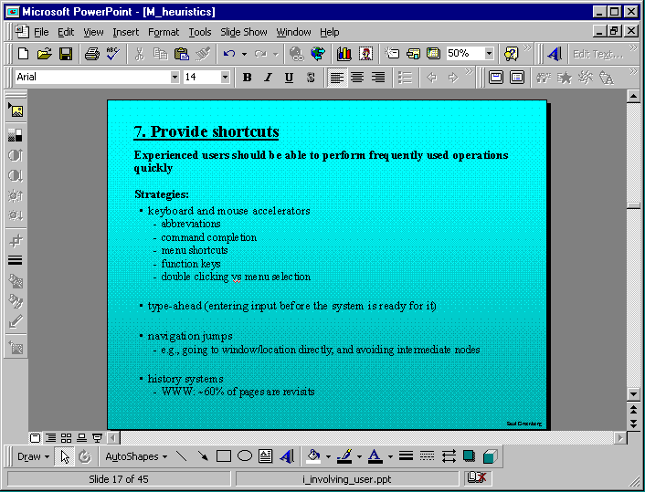
Keyboard accelerators for menus
Customizable toolbars and
palettes for frequent actions
Split menu, with recently used fonts on top
Double-click raises toolbar dialog box
Double-click raises object-specific menu
Scrolling controls for page-sized increments
Microsoft Powerpoint

Slide 53
Nielsen’s Ten Heuristics
Aesthetic and minimalist design
  Dialogs should not contain information that is irrelevant or rarely needed. Every extra unit of information in a dialog competes with the relevant units of information and diminishes their relative visibility.

Slide 54
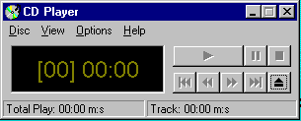
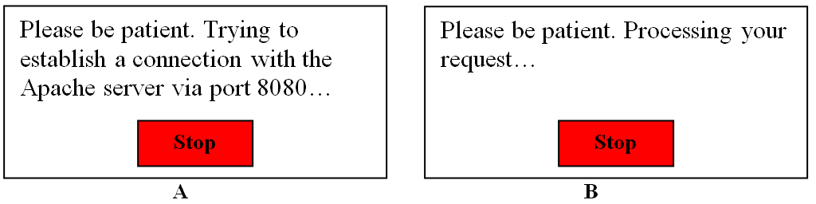
7. Minimalist Design
  use the user’s conceptual model
  match the users’ task sequence
  minimize mapping between interface and task semantics

Slide 55
7. Minimalist Design
Present exactly the information the user needs
  less is more
    less to learn, to get wrong, to distract...
  information should appear in natural order
    related information is graphically clustered
    order of accessing information matches user’s expectations
  remove or hide irrelevant or rarely needed information
    competes with important information on screen
  remove modes
  use windows sparingly
    don’t add unneeded navigation and window management

Slide 56
7. Minimalist Design
CompuServe Information Manager
File Edit Services Mail Special Window Help
Services
Telephone Access Numbers
PHONES
Access Numbers & Logon Instructions
United States and Canada
United States and Canada
CompuServe Network
Only 9600 Baud
List
? List
List by:
State/Province
Area Code

Slide 57

7. Minimalist Design

Slide 58
Nielsen’s Ten Heuristics
Error prevention
  Make it difficult to make errors. Even better than good error messages is a careful design that prevents a problem from occurring in the first place.
  For example: select file from menu rather than typing in name, confirmation before dangerous actions, beware of modes, avoid similar command names, warning if Caps Lock is activated when entering a password, etc.

Slide 59
8. Prevent Errors
Prevent errors
  try to make errors impossible
  modern widgets: can only enter legal data
Provide reasonableness checks on input data
  on entering order for office supplies
    5000 pencils is an unusually large order. Do you really want to order that many?

Slide 60
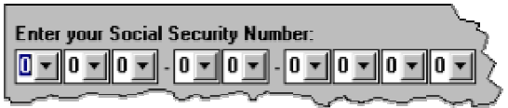
8. Prevent Errors

Slide 61
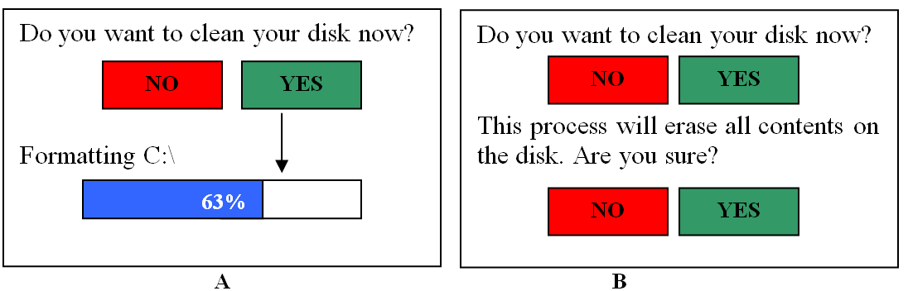
8. Prevent Errors

Slide 62
Nielsen’s Ten Heuristics
Help users recognize, diagnose and recover from errors [Good Error Messages]
  Error messages should be expressed in plain language (no codes), precisely indicate the problem, and constructively suggest a solution.
  Phrase error messages defensively, never blame the user. Multilevel messages. Link to help system.

Slide 63
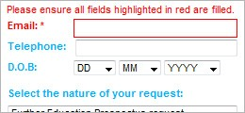
Help users recognize, diagnose and recover from errors

Slide 64
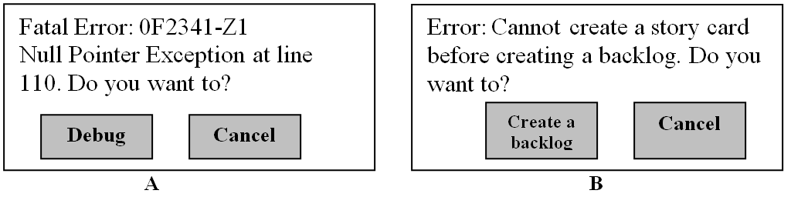
9. Deal with errors in a positive manner
Help users recognize, diagnose and recover from errors

Slide 65
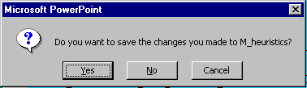
9. Deal with errors in a positive manner
I can’t believe I pressed Yes...

Slide 66
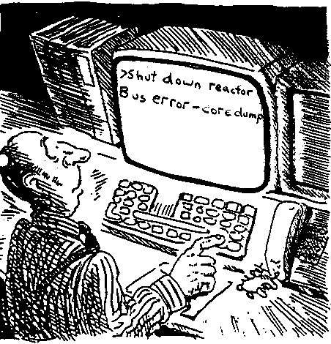
9. Deal with errors in a positive manner
A problematic message to a nuclear power plant operator

Slide 67
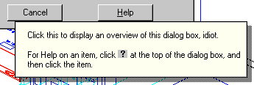
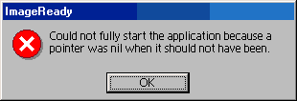
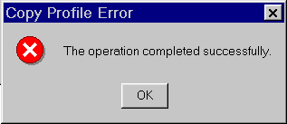
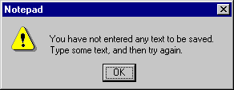
9. Deal with errors in a positive manner

Slide 68
9. Deal with errors in a positive manner
Provide meaningful error messages
  error messages should be in the user’s task language
  don’t make people feel stupid
    Try again, bonehead!
    Error 25
    Cannot open this document
    Cannot open “chapter 5” because the application “Microsoft Word”
    is not on your system
    Cannot open “chapter 5” because the application “Microsoft Word”
    is not on your system. Open it with “Teachtext” instead?

Slide 69
Nielsen’s Ten Heuristics
Help and documentation
  Few systems can be used with no instructions so it may be necessary to provide help and documentation. Any such information should be easy to search, focused on the user’s task, list concrete steps to be carried out, and not be too large.

Slide 70
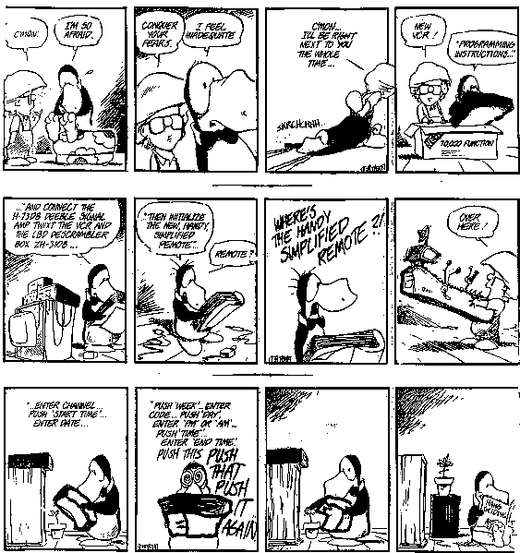
Manuals...

Slide 71
10. Provide help
Ability to use system
No/minimal docs
Good Usability

Slide 72
10. Provide help
Help is not a replacement for bad design!
Simple systems:
  walk up and use; minimal instructions
Most other systems
  feature rich
  simple things should be simple
  learning path for advanced features
Volume 37:
A user's
guide to...

Slide 73
10. Provide help
Many users do not read manuals
  prefer to spend their time pursuing their task
Usually used when users are in some kind of panic
  paper manuals unavailable in many businesses!
    e.g. single copy locked away in system administrator’s office
  online documentation better
  good search/lookup tools
  online help specific to current context
Sometimes used for quick reference
  syntax of actions, possibilities...
  list of shortcuts ...

Slide 74
10. Types of help
Tutorial and/or getting started manuals
  short guides that people are likely to read when first obtaining their systems
    encourages exploration and getting to know the system
    tries to get conceptual material across and essential syntax
  on-line “tours”, exercises, and demos
    demonstrates very basic principles through working examples

Slide 75
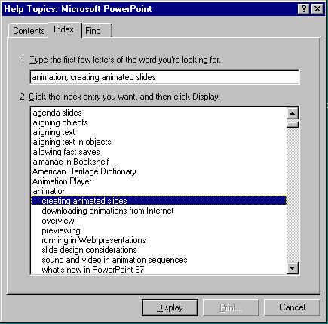
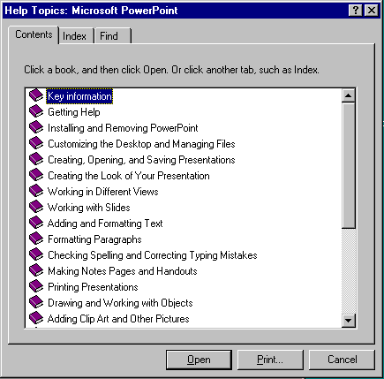
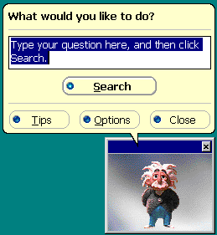
10. Types of help
Reference manuals
  used mostly for detailed lookup by experts
    rarely introduces concepts
    thematically arranged
  on-line hypertext
    search / find
    table of contents
    index
    cross-index
Microsoft Help

Slide 76
10. Types of help
Reminders
  short reference cards
    expert user who just wants to check facts
    novice who wants to get overview of system’s capabilities
  tooltips and other context-sensitive help
    text over graphical items indicates their meaning or purpose
Microsoft Word

Slide 77
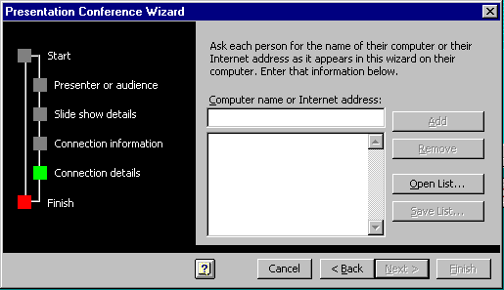
10. Types of help
Wizards
  walks user through typical tasks
  but dangerous if user gets stuck
What’s my computer’s name?
Fred?
Intel?
AST?
Microsoft Powerpoint

Slide 78
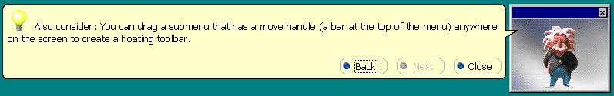
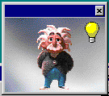
10. Types of help
Tips
  migration path to learning system features
  also context-specific tips on being more efficient
  must be “smart”, otherwise boring and tedious
Microsoft Word

Slide 79
Chunking the Heuristics
Meet expectations
  Match the real world
  Consistency & standards
  Help & documentation
User is the boss
  User control & freedom
  Visibility of system status
  Flexibility & efficiency
Handle errors
  Error prevention
  Recognition, not recall
  Error reporting, diagnosis, and recovery
Keep it simple
  Aesthetic & minimalist design

Slide 80
Shneiderman’s 8 Golden Rules
Strive for consistency
Enable frequent users to use shortcuts
Offer informative feedback
Design dialogs to yield closure
Offer error prevention and simple error handling
Permit easy reversal of actions
Support internal locus of control
Reduce short-term memory load
Notes:
1. Strive for consistency.
Consistent sequences of actions should be required in similar situations; identical terminology should be used in prompts, menus, and help screens; and consistent color, layout, capitalization, fonts, and so on should be employed throughout. Exceptions, such as required confirmation of the delete command or no echoing of passwords, should be comprehensible and limited in number.
2. Cater to universal usability.
Recognize the needs of diverse users and design for plasticity, facilitating transformation of content. Novice to expert differences, age ranges, disabilities, and technological diversity each enrich the spectrum of requirements that guides design. Adding features for novices, such as explanations, and features for experts, such as shortcuts and faster pacing, can enrich the interface design and improve perceived system quality.
3. Offer informative feedback.
For every user action, there should be system feedback. For frequent and minor actions, the response can be modest, whereas for infrequent and major actions, the response should be more substantial. Visual presentation of the objects of interest provides a convenient environment for showing changes explicitly.
4. Design dialogs to yield closure.
Sequences of actions should be organized into groups with a beginning, middle, and end. Informative feedback at the completion of a group of actions gives operators the satisfaction of accomplishment, a sense of relief, a signal to drop contingency plans from their minds, and an indicator to prepare for the next group of actions. For example, e-commerce web sites move users from selecting products to the checkout, ending with a clear confirmation page that completes the transaction.
5. Prevent errors.
As much as possible, design the system such that users cannot make serious errors; for example, gray out menu items that are not appropriate and do not allow alphabetic characters in numeric entry fields. If a user makes an error, the interface should detect the error and offer simple, constructive, and specific instructions for recovery. For example, users should not have to retype an entire name-address form if they enter an invalid zip code, but rather should be guided to repair only the faulty part. Erroneous actions should leave the system state unchanged, or the interface should give instructions about restoring the state.
6. Permit easy reversal of actions.
As much as possible, actions should be reversible. This feature relieves anxiety, since the user knows that errors can be undone, and encourages exploration of unfamiliar options. The units of reversibility may be a single action, a data-entry task, or a complete group of actions, such as entry of a name-address block.
7. Support internal locus of control.
Experienced users strongly desire the sense that they are in charge of the interface and that the interface responds to their actions. They don’t want surprises or changes in familiar behavior, and they are annoyed by tedious data-entry sequences, difficulty in obtaining necessary information, and inability to produce their desired result.
8. Reduce short-term memory load.
Humans’ limited capacity for information processing in short-term memory (the rule of thumb is that we can remember "seven plus or minus two chunks" of information) requires that designers avoid interfaces in which users must remember information from one screen and then use that information on another screen. It means that cell phones should not require re-entry of phone numbers, web-site locations should remain visible, multiple-page displays should be consolidated, and sufficient training time should be allotted for complex sequences of actions.
These underlying principles must be interpreted, refined, and extended for each environment. They have their limitations, but they provide a good starting point for mobile, desktop, and web designers. The principles presented in the ensuing sections focus on increasing users’ productivity by providing simplified data-entry procedures, comprehensible displays, and rapid informative feedback to increase feelings of competence, mastery, and control over the system.

Slide 81
Norman’s 7 Principles
Use both knowledge in the world and knowledge in the head.
Simplify the structure of tasks.
Make things visible: bridge the gulfs of Execution and Evaluation.
Get the mappings right.
Exploit the power of constraints, both natural and artificial.
Design for error.
When all else fails, standardize.

Slide 82
Performing a Heuristic Evaluation
Design may be verbal description, paper mock-up, working prototype, or running system. [When evaluating paper mock-ups, pay special attention to missing dialogue elements!]
Provide evaluators with checklist of usability heuristics
Optionally provide evaluators with some domain-specific training
Each evaluator works alone (1–2 hours)
Interface examined in two passes: first pass focuses on general flow, second on particular elements in detail.
Notes taken either by evaluator or evaluation manager
Make list of potential problems and list of positive findings

Slide 83
Performing a Heuristic Evaluation
Take screen shots as you work - they may not be reproducible later
Independent findings are then aggregated into one large list (by evaluation manager). This is best done with a spreadsheet
The large list of potential problems is distributed to each evaluator
Each evaluator now assigns severity ratings individually to each problem in the large list (unseen by the other evaluators)
The individual severity ratings are averaged to obtain the final severity rating for each problem
The long list is sorted in decreasing order of average severity
Group debriefing session to suggest possible redesigns

Slide 84
Sample spread sheet
Serial no. | Problem | Heuristic | Suggestion | Severity
1 | The “Cancel” button is missing from the XXX dialogue box | User control and freedom, consistency | Add “Cancel” button at the right side of “OK” button | 3
2 | The color of the “XXX” button on screen “ABC” is a bit lighter than the other buttons | Consistency | Change the color to a bit darker shade | 1
Score | Severity
0 | I don’t agree that this is a usability problem at all
1 | Cosmetic problem only: need not be fixed unless extra time is available on project
2 | Minor usability problem: fixing this should be given low priority
3 | Major usability problem: important to fix, so should be given high priority
4 | Usability catastrophe: imperative to fix this before product can be released

Slide 85
Useful Links
https://usabilitygeek.com/heuristic-evaluation-introduction/
https://uxdesign.cc/ux-case-study-heuristic-analysis-of-yuppiechef-com-c92098052ce4
https://uxgorilla.com/heuristic-evaluation/
https://blog.prototypr.io/10-usability-heuristics-with-examples-4a81ada920c

